Slide 1
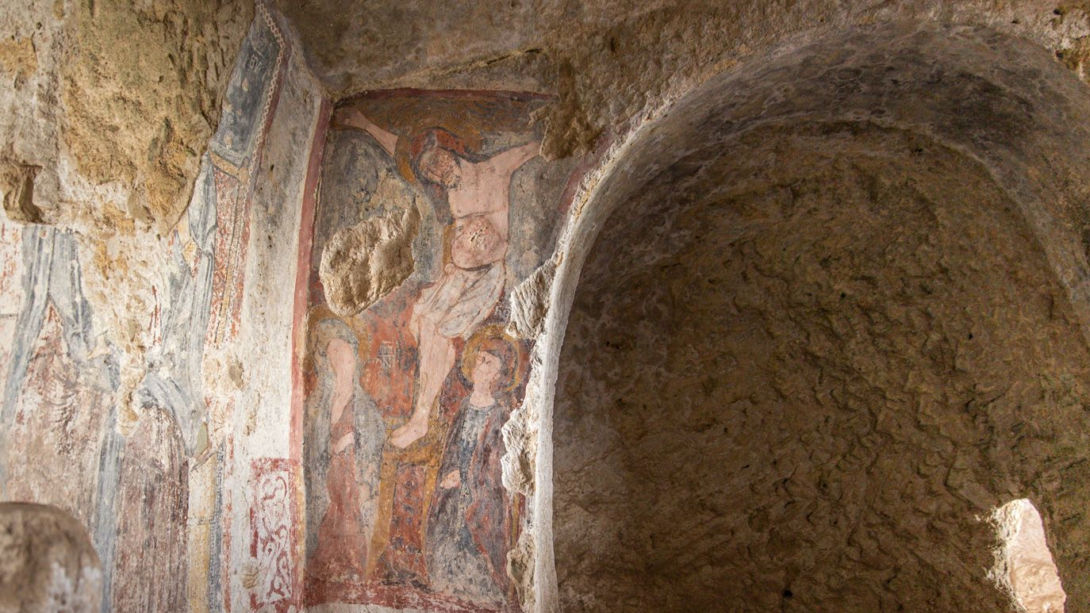

Torn apart
Final Project for
XR&AI Summer School 2022
Francavilla Anna, Reply S.p.A.
Stacchio Lorenzo, PhD candidate at UniBo
Veggi Manuele, MA student at UniBo

Slide 2
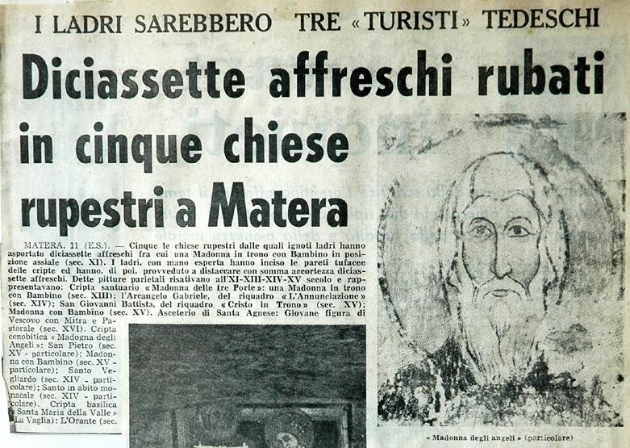
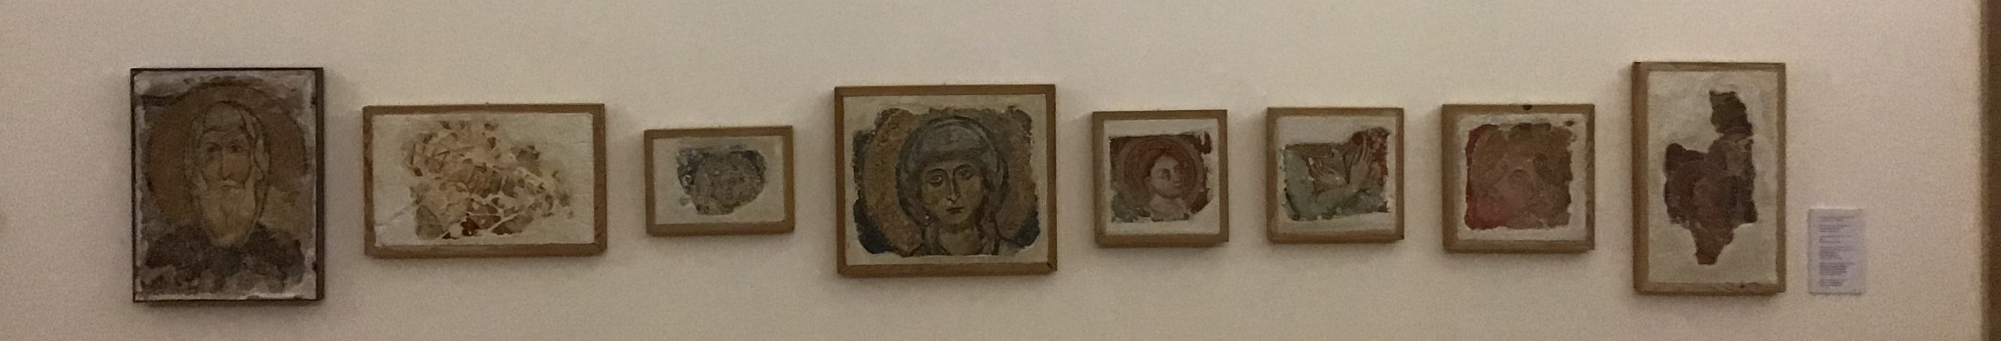
The context and the asset
Rock churches of Matera
Rudolf Kubesh and his equipe: an unorthodox and illegal frescoes tearing
Partial recovery, now exhibited in Lanfranchi Museum, Matera

Slide 3
The educational goal

